Slide 1
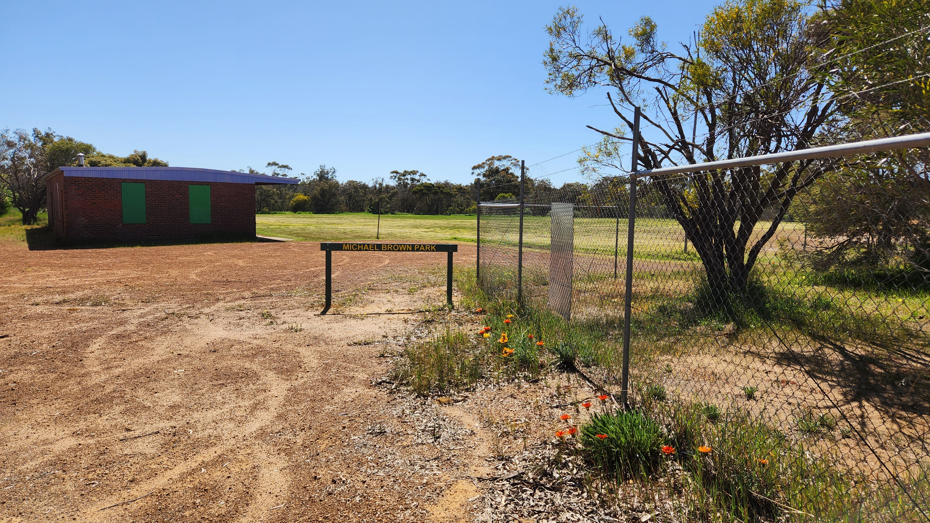
The former Little Athletics Oval is located on Bannister Street is named after Michael Brown, who came to Narrogin around 1888, when he ran the Wayside Inn. By the late 1890s he had erected the Hordern Hotel and other premises. He was first a Chairman of the Narrogin Road Board, and then Mayor of Narrogin. He was also a president of the Narrogin Agricultural Society.

